Slide 1


HVS​
Concept of Error Management

Slide 2

Contents
Communication errors
HV Safety
Reaction on vehicle
Diagnosis interfaces

Slide 3
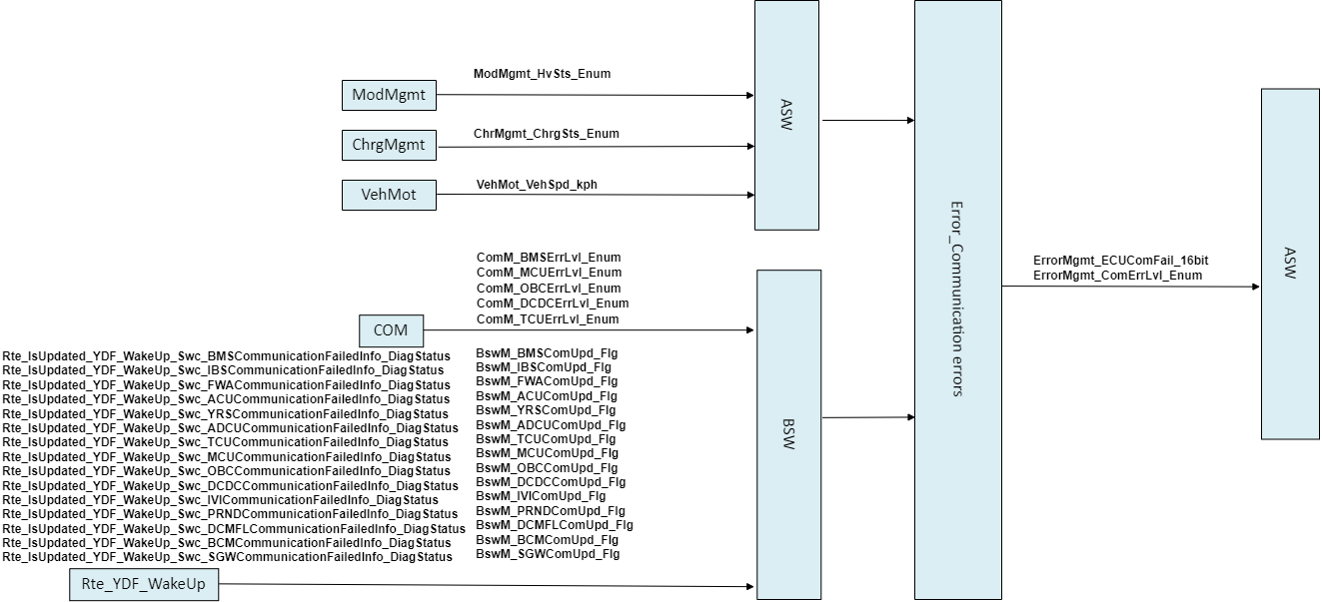
Communication errors
The module is responsible for the judgment of network loss and the fault level of the vehicle caused by other ECUs, and does the rate conversion between different cycles of communication in the module.

Slide 4
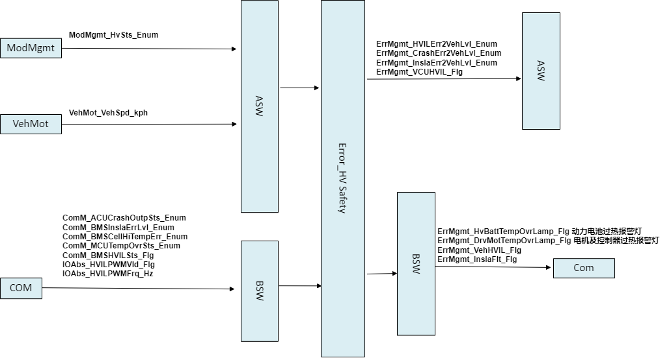
HV Safety
The module is responsible for the judgment of insulation, interlock, crash and thermal runaway, as well as the corresponding fault level of the vehicle, to the Diag module; And output BMS and MCU thermal runaway signals to the network.

Slide 5
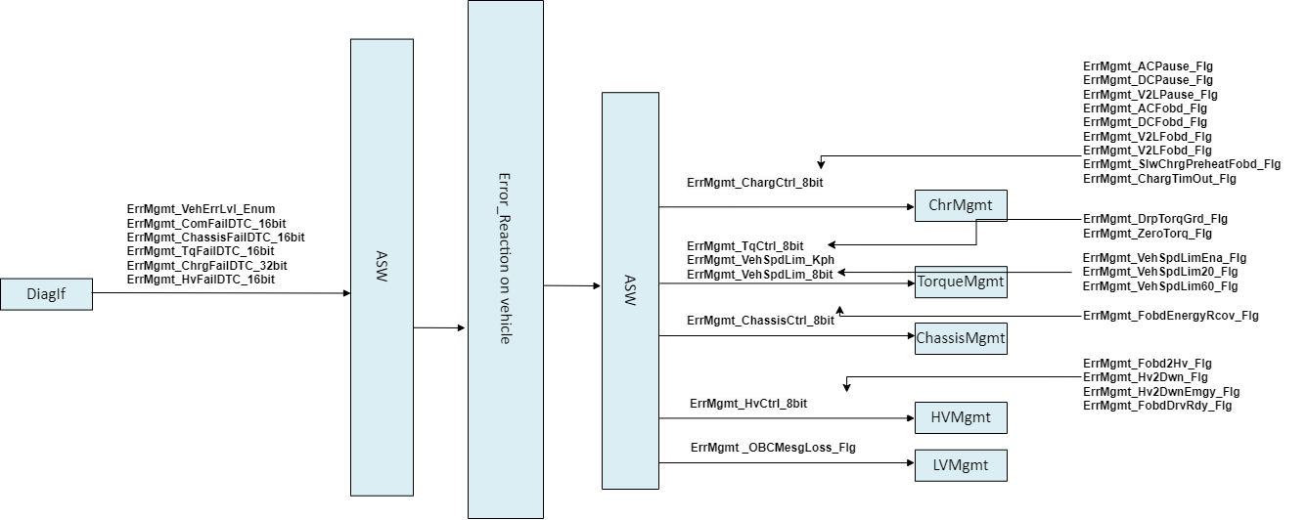
Reaction on vehicle
This module is responsible for sorting out vehicle faults and functional faults of Diag module, and outputs corresponding operations to other modules.

Slide 6
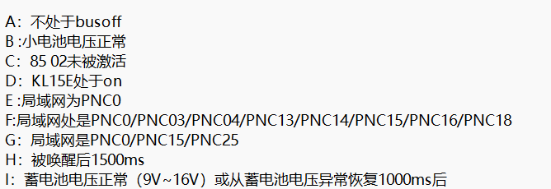
Diagnosis interfaces
This module is responsible for summarizing the faults output by HVS and Com modules, enabling the premise of the function module in this module, and after judging the function fault, the final vehicle fault signal and the fault light signal caused by the fault level are output to the CAN network. Output the fault flag bit corresponding to DTC to the DEM module of BSW.

Slide 7
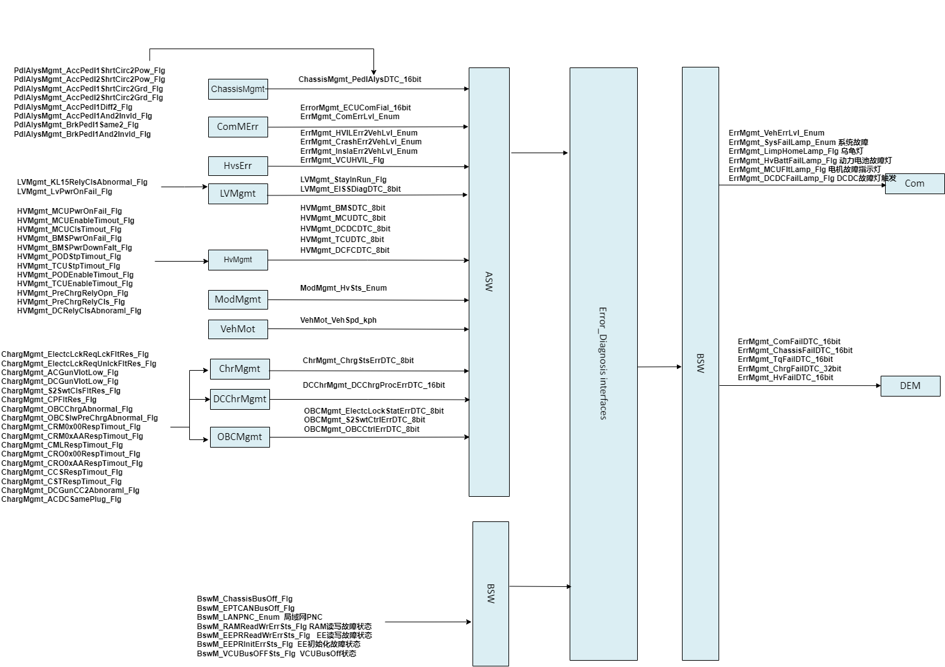
Diagnosis interfaces

Slide 8
Backup

